Slide 1
Sudoku Solver
Part I

Slide 2
A few more tools...
Multi-Dimensional List: you know what a list is in Python (denoted by []), you need to know that it is possible to make a List of Lists, this is called a ‘2d List’ or ‘2d array’, and resembles a matrix.
2d List Indexing: You know how to index a list (my_list[2]), to acess and index inside of a 2d list, or matrix, simply specifiy the row (r) and column (c) number you want, i.e. my_list[1][2].
Simple Example:
# initialize my_list to be a 3x3 Matrix
my_list = [ [1, 2, 3, 4], [“Dane”, “Parker”, “Jenna”], [True, False, False] ]
# get item at row 1, column 2 from my_list
item_value = my_list[1][2] # item_val will equal “Jenna”

Slide 3
A few more tools...
Set Datatype: a set in python is kind of like a list, except for a few differences:
1. Sets are denoted by either the keyword set() or curly braces {}
2. Sets have UNIQUE values, i.e. no duplicate values allowed.
3. You can perform set operations such as set difference, subset, etc (we will use set difference)
4. instead of my_list.append(1), it is my_set.add(1)
Example:
my_set = set()
my_set.add(1)
my_set.add(2)
my_set.add(1) # this will add 1 to the set IF it isn’t in the set already
first_item = my_set.pop() # first_item will be 2

Slide 4
Sudoku 9x9
The object is to place the numbers 1 to 9 in the empty cells so that each row, each column and each 3x3 box contains the same number only once.
You can do this by visiting any cell in any order and placing/removing/switching numbers (1-9) in that cell until you get it right (i.e., the correct number for that cell)

Slide 5
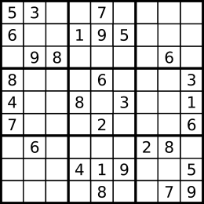
Sudoku Board Parts / Terminology
Column
= Cell
= Box
Row

Slide 6
Sudoku Board Parts / Terminology
Cell at position [0][0]
Cell at position [1][8]
Cell at position [8][8]
Cell at position [8][1]

Slide 7
Sudoku Algorithms
There are many (complicated) algorithms for solving Sudoku, and it is a very popular problem in Computer Science. Computer Scientists and mathematicians are always trying to find a better, faster algorithm that will scale with the size of a Sudoku board (i.e., have the same proportional completion time for different sizes of boards).
Some algorithms include Stochastic search / optimization methods, constraint programming, exact cover, and Brute Force (Backtracking).
A simple search for ‘Sudoku Solving Algorithms’ will let you explore more of these complex algorithms.
https://en.wikipedia.org/wiki/Sudoku_solving_algorithms

Slide 8
Sudoku Algorithms
How do YOU solve a sudoku puzzle? Could you write down a list of steps that I could take on a Sudoku Board that would lead me to solving it?
Think about this, it is important. Conveying your problem solving skills / steps in a simple, systematic, and instructive list is the fist step to creating a program to solve the problem for you.
As we have previously discussed, there are many algorithms, and yours may be different from the person sitting next to you.

Slide 9
Brute Force (Backtracking)
Brute force: is a trial and error method used to solve a problem.
Idea: the way our program will solve the sudoku board is by starting at the first cell and placing a valid number in each cell until no valid numbers are found. The program will then go back (i.e. backtrack) and change a previous cell’s value, then move forward and try again.
This is an animated gif of a computer solving a sudoku board using a backtracking algorithm

Slide 10
Backtracking fun facts
Interesting Facts:
Approximately 6.67 x 10²¹ final grids exist.
There are Sudoku boards designed to work against this backtracking algorithm, such a puzzle will have few clue, no clues in the top row, or the solution ‘987654321’ for the first row.
In one case, a brute force program required 6 hours to arrive at a solution for such a Sudoku (using 2008 era computer technology)

Slide 11
Our Backtracking Algorithm
Check if board is valid, return False if its not
While each cell does not have a number, do:
get the current cell
if the cell does not have a number
get possible numbers for this cell
if there are possible numbers
try one,
add the cell to cells tried list
else if cells tried is not empty,
reset this cell
get the previous cell and remove it from cells tried list
attempt to put a different number in previous cell
otherwise the board is unsolvable
go to the next cell
done

Slide 12

Try it

Slide 13
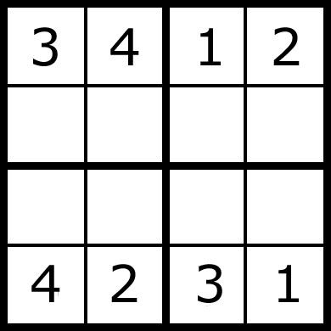
Little harder

